Slide 1
Introduction to .NET
Florin Olariu
“Alexandru Ioan Cuza”, University of Iași
Department of Computer Science

Slide 2
Agenda
WebSummit
Impressions
A nice story about efficiency, pragmatism
KATA MVC Core Scaffolding using EF Core(Tips&Tricks)
Using Dependency Injection with ASP.NET Core
ASP.NET MVC Core 2.0
Models, views and controllers – an MVC refresher
Understanding MVC

Slide 3
WebSummit

Slide 4
WebSummit
“Build more. Code less.”

Slide 5
WebSummit
“Build more. Code less.”
“Software is eating the world. – We are just little vegetables floating in software soup.”

Slide 6
WebSummit
“Build more. Code less.”
“Software is eating the world. – We are just little vegetables floating in software soup.”
Viability
Feasibility
Desirability
Notes:
Viability: Can it make money?
Desirability: Does anyone want it?
Feasibility: Can it be done?

Slide 7
Using Dependency Injection with ASP.NET
IoC/DI mechanisms
Notes:
Inversion of Control (IoC) is one of those topics that tends to get dismissed by some developers as an advanced concept that they may never need.
In the past, developers have had the choice of either rolling out their own code or using one of the many IoC containers to introduce
Dependency Injection (DI) in their code.
With ASP.NET Core, you will have the choice of using the built-in DI features or making use of existing IoC containers that you may already be familiar with.

Slide 8
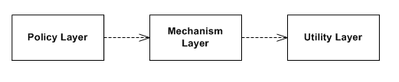
Using Dependency Injection with ASP.NET
IoC/DI mechanisms
Notes:
The idea is to remove the dependencies.

Slide 9
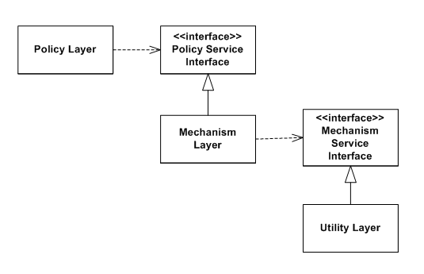
Using Dependency Injection with ASP.NET
IoC/DI mechanisms
Notes:
Solution:
Extract 2 interfaces: one for PolicyLayer and one for MechanismLayer.
Add the relations using the interfaces.
IoC is a well-known pattern that invents the control of how dependent objects are created within software components.
Using DI allows us to implement IoC in our software applications.

Slide 10
Using Dependency Injection with ASP.NET
IoC/DI mechanisms
PROS | CONS
Helps with adhering to the Dependency Inversion Principle (DIP) | DI introduces a learning curve for some developers
Allows objects to be easily swapped with replacements | DI may require a significant overhaul of existing projects
Facilitates the use of the Strategy Design Pattern (SDP)
Improves the testability of applications
Enables loose coupling of software components
Notes:
DIP:
High-level modules should not depend on low-level modules. Both should depend on abstractions.
B. Abstractions should not depend on details. Details should depend on abstractions.

Slide 11
Using Dependency Injection with ASP.NET
IoC/DI mechanisms
Notes:
Lifetime management.

Slide 12
Using Dependency Injection with ASP.NET
IoC/DI mechanisms
Transient
Notes:
Transient : A new instance will be created each time the object is needed

Slide 13
Using Dependency Injection with ASP.NET
IoC/DI mechanisms
Transient
Scoped
Notes:
Transient : A new instance will be created each time the object is needed.
Scoped: A new instance will be created for each web request.

Slide 14
Using Dependency Injection with ASP.NET
IoC/DI mechanisms
Transient
Scoped
Singleton
Notes:
Transient : A new instance will be created each time the object is needed.
Scoped: A new instance will be created for each web request.
Singleton: A new instance will be created only once at application startup.

Slide 15
Using Dependency Injection with ASP.NET
IoC/DI mechanisms
Transient
Scoped
Singleton
Instance (special case of Singleton) – AddSingleton()
Notes:
Transient : A new instance will be created each time the object is needed.
Scoped: A new instance will be created for each web request.
Singleton: A new instance will be created only once at application startup.
Instance : Use AddSingleton() and create an instance yourself.

Slide 16
Using Dependency Injection with ASP.NET
IoC/DI mechanisms
Transient
Scoped
Singleton
Instance (special case of Singleton)
Notes:
There are 2 types of DI.

Slide 17
Using Dependency Injection with ASP.NET
IoC/DI mechanisms
Transient
Scoped
Singleton
Instance (special case of Singleton)
Constructor injection
Notes:
There are 2 types of DI.

Slide 18
Using Dependency Injection with ASP.NET
IoC/DI mechanisms
Transient
Scoped
Singleton
Instance (special case of Singleton)
Constructor injection
Action injection
Notes:
There are 2 types of DI.
When you inject a dependency through the constructor, this method is known as constructor injection.
If you inject it in an action method, that is known as action injection.
You can use either approach in your application.
Sample for action injection:
public IActionResult ActionMethod([FromServices] IApptService apptService)
{
ViewData[" Message"] = "Scheduled: " + apptService.ScheduleAppt();
return View();
}

Slide 19
ASP.NET MVC Core 2.0

Slide 20
Models, views and controllers – an MVC refresher
Notes:
For those of you not familiar with MVC, here's a quick refresher that also includes information that is new to ASP.NET Core.
The following figure shows a simple architecture diagram that represents the MVC software architectural pattern:

Slide 21
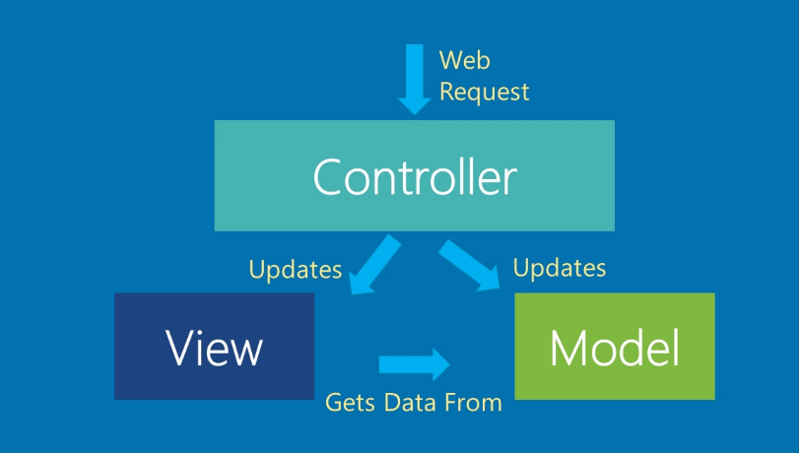
Models, views and controllers – an MVC refresher
Notes:
Each web request gets routed through a specific controller to determine the result that will be displayed in the user's web browser.
MVC itself wasn't a new concept when Microsoft first released ASP.NET MVC.
But it immediately introduced .NET developers to a new way of developing web applications.
The benefits over Web Forms became apparent to early adopters:
clearer separation of concerns
better testability
lightweight client output that can be customized.

Slide 22
Models, views and controllers – an MVC refresher
Controllers
Notes:
We can say that controllers are the heart of your ASP.NET MVC application.
A controller is responsible to handle user requests.
This is based on route matching.
The role is to update data into a model and then to pick up a view to return back to users.

Slide 23
Models, views and controllers – an MVC refresher
Controllers
Is a subclass of the base class Controller

Slide 24
Models, views and controllers – an MVC refresher
Controllers
Is a subclass of the base class Controller
Lives into the following namespace: Microsoft.AspNetCore.Mvc
Notes:
This is different from the Controller class from prior versions of ASP.NET, which lived in the System.Web.Mvc namespace.
In fact, the new Controller base class is also used by Web API controllers.

Slide 25
Models, views and controllers – an MVC refresher
Controllers
Is a subclass of the base class Controller
Lives into the following namespace: Microsoft.AspNetCore.Mvc
Typically a controller returns an IActionResult from its action methods
Notes:
For web application projects, this could be a view.
For Web API projects, this could be a set of data.
It is possible to return both views and results from a controller.

Slide 26
Models, views and controllers – an MVC refresher
Models
Notes:
Each model class can represent entities in your code, while decorated by attributes surrounded by square brackets.

Slide 27
Models, views and controllers – an MVC refresher
Models
Typically a model is DTO class (properties)
Notes:
By binding your models to your views, each view will automatically determine what to display and how to display it.

Slide 28
Models, views and controllers – an MVC refresher
Models
Typically a model is DTO class (properties)
For a cleaner architecture, you can use a view-specific model (or ViewModel) to bind to a view.
Notes:
You can use a repository pattern with a service layer for models that reflect your database entities through Entity Framework.
This will let you have UI elements that don't have to rely on the structure of your database entities.

Slide 29
Models, views and controllers – an MVC refresher
Views
Notes:
The views in your application are probably the simplest part of MVC.
Each view represents the UI layer, resulting in client-side HTML, CSS, and JavaScript that will be displayed to the end user.

Slide 30
Models, views and controllers – an MVC refresher
Views
Views are stored in .cshtml files
Notes:
The views have the ability to include server-side code and client-side code in the same file.

Slide 31
Models, views and controllers – an MVC refresher
Views
Views are stored in .cshtml files
ViewBag allows you to store your own properties and display them in the view.
Notes:
The ViewBag object and its properties can be manipulated by your controller code.
ViewBag is a dynamic dictionary.

Slide 32
Models, views and controllers – an MVC refresher
Views
Views are stored in .cshtml files
ViewBag allows you to store your own properties and display them in the view.
We can use tag helpers in your views for smoother syntax.
Notes:
A tag helper allows you to use custom attributes within your HTML tags that may be familiar to developers who use AngularJS.

Slide 33
Understanding MVC
Notes:
This chapter will cover what you need to know about each of the following areas:
Controllers Views Models Parts of this chapter will be familiar to developers who have already worked with previous versions of ASP.NET MVC.
We will go through some familiar material, while revealing newer additions to MVC along the way.

Slide 34
Understanding MVC
Implementing controllers
HttpGet: Uses the HTTP GET method with optional querystring parameters
HttpPost: Uses the HTTP POST method for form submissions to create an entity
Notes:
Your MVC controller is where the magic happens.
Requests come in from the end-user, then content and data get returned.
What happens in between is up to you-the developer.
Probably the most common usages of HTTP is HttpGet and HttpPost.
Another useful Http verbs are:

Slide 35
Understanding MVC
Implementing controllers
HttpGet: Uses the HTTP GET method with optional querystring parameters
HttpPost: Uses the HTTP POST method for form submissions to create an entity
HttpPut: Uses the HTTP PUT method to edit an existing entity
HttpDelete: Uses the HTTP DELETE method to delete an existing entity
HttpPatch: Allows partial model updates instead of a full PUT request
AcceptVerbs: Allows multiple action verbs to be specified

Slide 36
Understanding MVC
Implementing views
Notes:
Views in MVC make up the presentation layer, the user interface that holds on-screen elements for the user to interact with.

Slide 37
Understanding MVC
Implementing views
ViewData, ViewBag, and TempData
Notes:
You can pass data from your controllers to your views by setting the values using ViewData items in a controller, and then retrieving the values in a view.
These values are stored as key-value dictionary items with string-based keys.
ViewBag is a more dynamic alternative to using ViewData, allowing you to use complex data types without typecasting.
The assigned value will be reset upon a redirect.
A sample:

Slide 38
Understanding MVC
Implementing views
ViewData, ViewBag, and TempData
ViewData[" PatientId"] = id;
ViewBag.PatientData = "someData";
TempData[" UserToken"] = userTokenData;
@{
ViewData["Title"] = "Patient Details";
}
<h2> Patient Details </h2>
<ul>
<li> ID: @ViewData[" PatientId"] </li>
<li> Name: @ViewData[" PatientName"] </li>
</ul>

Slide 39
Understanding MVC
Implementing views
ViewData, ViewBag, and TempData
@{
ViewData[" Title"] = "Patient Index";
}
<h2> Patient Index, with Tag Helpers </h2>
<ul> @for (int i=0; i<10; i++) {
<li>
<a asp-controller =" Patient"
asp-action ="Details" asp-route-id ="@i"
asp-route-name ="Patient @i" >
Patient # @i </a></li>
}
</ul>
Notes:
In the preceding code, the for loop is used to generate a list of clickable links. Each link can be clicked to show the details for a particular patient.
Once again, you can see the use of tag helpers as the following attributes within the < a > tag: asp-controller asp-action asp-route-id asp-route-name
The last two attributes are open-ended enough to reference named parameters such as ID and name. The id attribute will automatically follow the URL routing convention, while the name attribute will be added as a QueryString parameter.
The links will appear in the following format:
http:// localhost: 12345/ Patient/ Details/ 0? name = Patient% 200
http:// localhost: 12345/ Patient/ Details/ 1? name = Patient% 201
http:// localhost: 12345/ Patient/ Details/ 2? name = Patient% 202

Slide 40
Understanding MVC
Implementing models and ViewModels
Notes:
Instead of passing around individual values one by one from controllers to views, you can use a model to store a set of data.
The controller is responsible for updating the model, which can be associated with a view to get its data.

Slide 41
Understanding MVC
Implementing models and ViewModels
A model is just a class file with a .cs file extension.
Notes:
A model belongs to “Models” folder from solution explorer.
In the previous version of MVC in order to bind a model to a view we had to use the following approach:

Slide 42
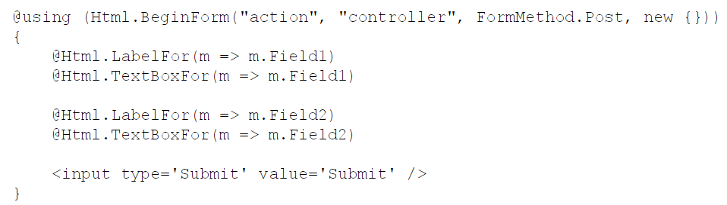
Understanding MVC
Implementing models and ViewModels
A model is just a class file with a .cs file extension.
Notes:
For MVC 6 we have to use the following approach:

Slide 43
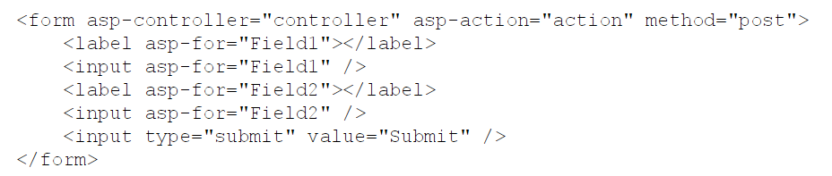
Understanding MVC
Implementing models and ViewModels
A model is just a class file with a .cs file extension.
Notes:
In order to map models to view models we have to use for instance automapper. (nuget package)
See the view model sample in the next slide.

Slide 44
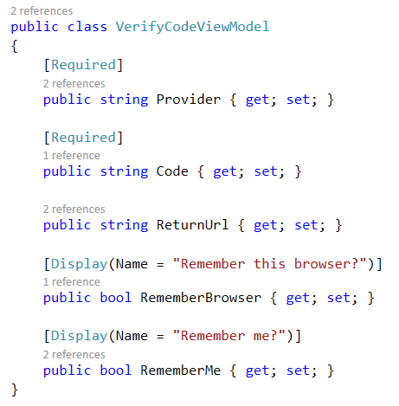
Understanding MVC
Implementing models and ViewModels
A model is just a class file with a .cs file extension.

Slide 45
One more thing…(1/2)
Notes:
In 2008 a very nice story related to MVC pattern.

Slide 46
One more thing…(2/2)
“Truth can only be found in one place: the code.”
by Robert C. Martin, Clean Code: A Handbook of Agile Software Craftsmanship

Slide 47
Bibliography
https://docs.microsoft.com/en-us/aspnet/core/tutorials/first-web-api- By Mike Wasson and Rick Anderson
Chowdhuri, Shahed. ASP.NET Core Essentials
Price, Mark J.. C# 7 and .NET Core: Modern Cross-Platform Development

Slide 48
Questions
Do you have any other questions?

Slide 49
Thanks!
See you next time! ☺

